Slide 1
Jadav Payeng: the forest man of india

Slide 2
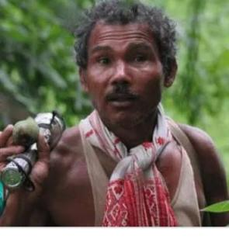
Jadav payeng
Jadav "Molai" Payeng (born 1963) is an environmental activist and forestry worker from Majuli, popularly known as the Forest Man of India.
Mājuli or Majuli is a river island in the Brahmaputra River, Assam and in 2016 it became the first island to be made a district in India.
Over the course of several decades, he has planted and tended trees on a sandbar of the river Brahmaputra turning it into a forest reserve.
The forest, called Molai forest after him, is located near Kokilamukh of Jorhat, Assam, India
Jadav Payeng belongs to the Mising tribe in Assam, India. He lives in a small hut in the forest.
Binita, his wife, and his 3 children (two sons and a daughter) accompany him.

Slide 3
What encouraged him for the plantation
In 1979, Payeng, then 16, encountered a large number of snakes that had died due to excessive heat after floods washed them onto the tree-less sandbar.
That is when he planted around 20 bamboo seedlings on the sandbar.
He started working on the forest in 1979 when the social forestry division of Golaghat district launched a scheme of tree plantation on 200 hectares at Aruna Chapori situated at a distance of 5 km from Kokilamukh in Jorhat district.
Molai was one of the labourers who worked in that project which was completed after five years.
He chose to stay back after the completion of the project even after other workers left. He not only looked after the plants, but continued to plant more trees on his own, in an effort to transform the area into a forest.

Slide 4

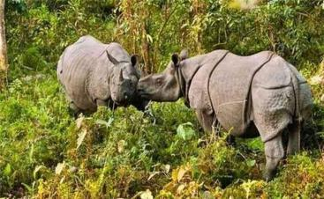
The forest, which came to be known as Molai forest, now houses Bengal tigers, Indian rhinoceros, and over 100 deer and rabbits.
Molai forest is also home to monkeys and several varieties of birds, including a large number of vultures.

Slide 5

Result of the efforts taken by jadav payeng
A herd of around 100 elephants regularly visits the forest every year and generally stays for around six months. They have given birth to 10 calves in the forest in recent years.

Slide 6

Inspiration
His story has been inspiring many film directors and documentry makers.
His character was the basis for a fictional film made by a Tamil director Prabhu solaman casting Rana Daggubati released in Tamil, Telugu, Hindi as Kaadan, Aranya and Hathi mera sathi.
A locally made documentary film, produced by Jitu Kalita in 2012, The Molai Forest, was screened at the Jawaharlal Nehru University.

Slide 7
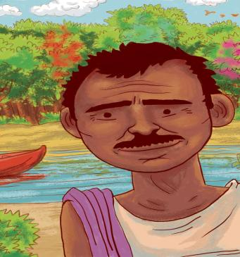
An illustration of Jadav Payeng, from the biographical children's book Jadav and the Tree-Place by Vinayak Varma

Slide 8

Honours
Jadav Payeng was honoured at a public function arranged by the School of Environmental Sciences, Jawaharlal Nehru University on 22 April 2012 for his achievement.
JNU vice-chancellor Sudhir Kumar Sopory named Jadav Payeng as the "Forest Man of India".
In the month of October 2013, he was honoured at the Indian Institute of Forest Management during their annual event
In 2015, he was honoured with Padma Shri, the fourth highest civilian award in India.

Slide 9
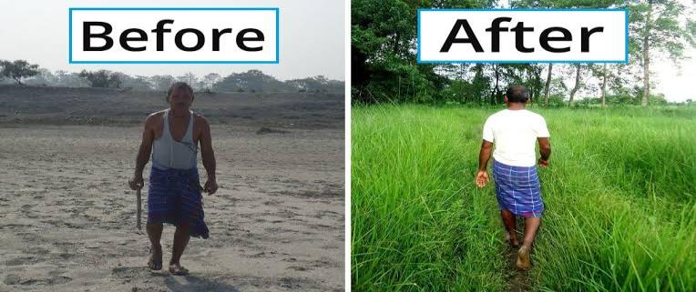
Results of his initiative

Slide 10
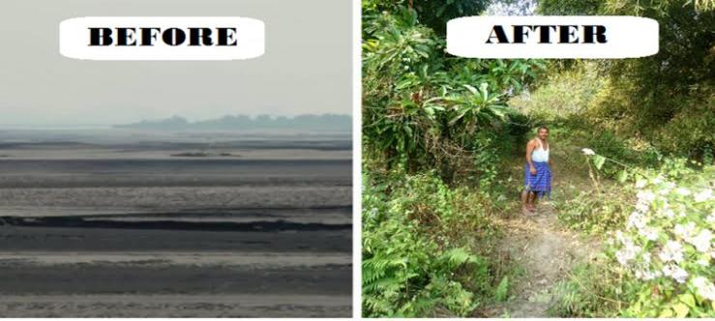
Results of his initiative

Slide 11
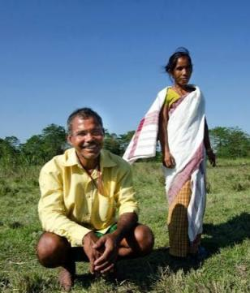
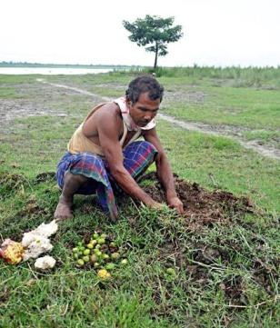
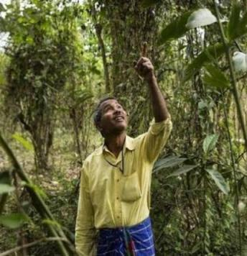
Jadav payeng on the field

Slide 12
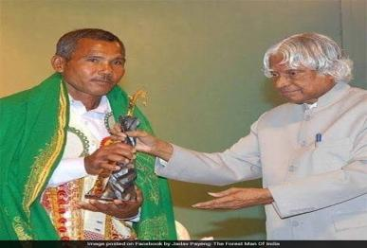
Thank You

